Slide 1

Fake News Detection within online social media using supervised artificial intelligence algorithms.
Name- Kshitij Sarawagi-181CO229, Sumeet Bisen-181CO254
Section- 2
Date- 22/04/2021
Submitted To- Dr. Venkatesan Sir

Slide 2


Slide 3
Supervised Learning
Supervised artificial intelligence algorithms are form of learning based on the training set.
They assume that the labels of instances in the data sets are already known. They require a training set of labeled data and return a function that instances to the supervised data.
The task of the function is to estimate the output having the minimum error rate from the input. In the upcoming section, information about supervised artificial intelligence algorithms used in this study is given.
The TF-IDF vectorizer is used in this study to convert the terms in the data set for each document into a vector of term of weights.

Slide 4
Data Pre-processing
Tokenization
Tokenization process divides the given text into smaller parts which are called tokens and it removes all the punctuations from the textual data. The number filter has been applied to remove terms which contain numbers. The case converter has been used to transform text data to lowercase or uppercase. In this paper, all the terms have been converted into lowercase. Finally, in this step, the N-chars filter has been used to delete the words, which consist of less than N characters.
Stop-words removal
Stop-words are not important words, although they are frequently used to complete the sentence structure and connect expressions. These words are language-specific words, which do not carry information. Conjunctions, pronouns, and prepositions are stop-words. There are about 400–500 stop-words in English. Some of the stop words are a, an, about, by, but, that, does, on, above, once, after, until, too, again, when, where, what, all, am, and, any, against, and so on.
Stemming
In this process, different grammatical forms of a word like its adjective, adverb, noun, verb, etc. have been transformed into its root form. The aim of stemming is to obtain the basic forms of the words whose meanings are the same, but the word forms are different from each other. For example, the words, connection, connections, connective, connected, and connecting can be stemmed to the word ‘connect’.

Slide 5
CLASSIFIERS
Three Classifiers are used in this project for news classification:
Logistic Regression
Decision Tree
Random Forest

Slide 6
Logistic Regression
Logistic regression is a form of regression analysis in which the outcome variable is binary or dichotomous
Used when the research method is focused on whether or not an event occurred, rather than when it occurred (time course information is not used).
• What is the “Logistic” component?
Instead of modeling the outcome, Y, directly, the method models the log odds(Y) using the logistic function.

Slide 7
Decision Tree
A decision tree is a decision support tool that uses a tree-like model of decisions and their possible consequences, including chance event outcomes, resource costs, and utility. It is one way to display an algorithm that only contains conditional control statements.
Decision trees classify instances by sorting them down the tree from the root to some leaf node, which provides the classification of the instance.
Decision trees perform classification without requiring much computation.

Slide 8
Random Forest
Random forests or random decision forests are an ensemble learning method for classification, regression and other tasks that operates by constructing a multitude of decision trees at training time and outputting the class that is the mode of the classes or mean/average prediction of the individual trees.
Random forest is a machine learning algorithm that uses a collection of decision trees providing more flexibility, accuracy, and ease of access in the output.
Random forest searches for the best feature from a random subset of features providing more randomness to the model and results in a better and accurate model.

Slide 9
Dataset- ISOT Fake News Dataset
This data set contains two types of news, fake and real news. Fake and real news are obtained from real-world sources.
The real news articles were collected from Reuters.com, while the fake news articles were collected from unreliable various websites such as Politifact and Wikipedia.
The data set consists of a total of 44 898 data, 21 417 real-labeled data and 23 481 false-labeled data.
10 samples from both the classes were dropped and were made into a new dataset for manually testing them with our already trained and tested algorithms.

Slide 10
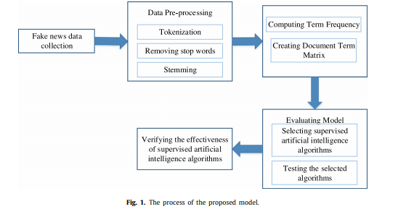
Model

Slide 11
Conclusion
In recent years, it has become difficult for users to access accurate and reliable information because of the increased amount of information on social media.
In this study, a model is proposed to detect fake news in social media by combining text mining methods and supervised artificial intelligence algorithms.
Text mining analysis and supervised artificial intelligence algorithms have been conducted separately.
All algorithms have accuracy more than 98%.

